Slide 1
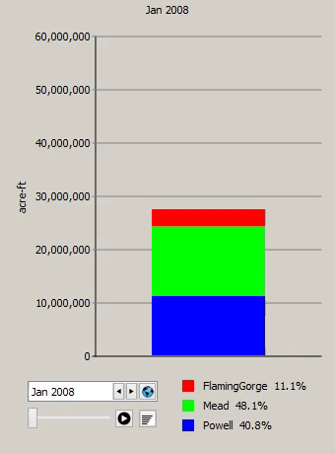
Export Chart Animation to Video File
Full run period (only)
One frame per timestep
or coarser sampling
Settable frames per sec.
Choice of:
  MP4, WEBM, WMF,
  Animated GIF
  Frame images only

Slide 2
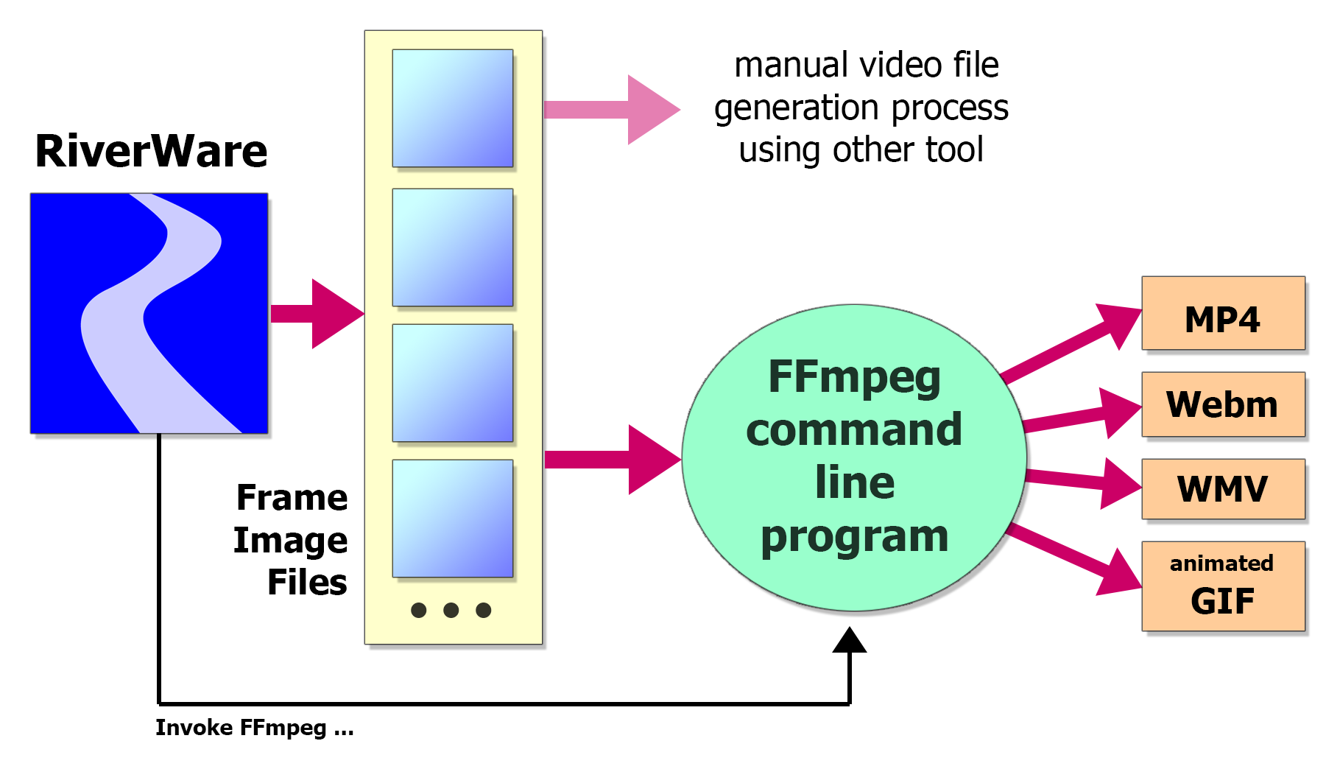
Export Chart Animation to Video File

Slide 3
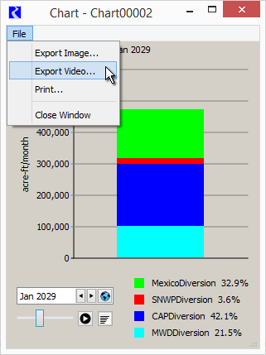
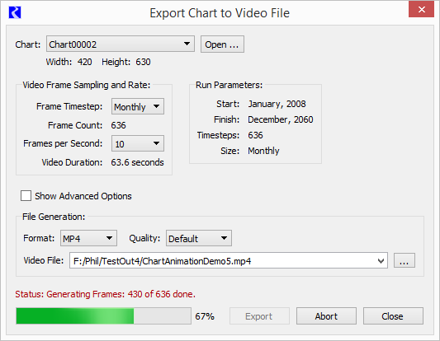

Slide 4
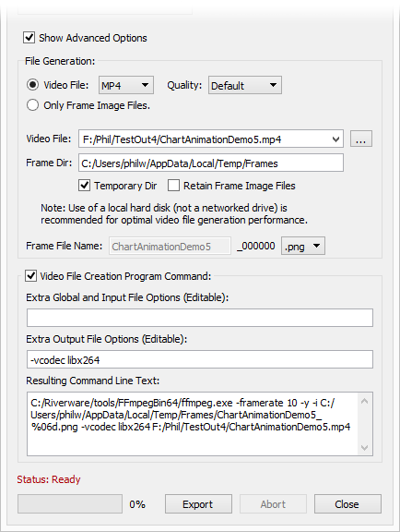
Export Video File
Advanced Options:
Generated frame image directory and names.
Retain frame images?
Extra FFmpeg arguments.
Copy generated FFmpeg command line.

