Slide 1
Outputs
FY16 RiverWare Sponsor Meeting
February 16, 2017

Slide 2
Model Reports – Highlights
Two new Slot Tables – Scalar Slot Grid / Periodic Slot Grid
Link Table
Show individual RPL Rule/Goal/Method

Slide 3
Model Reports – FY 17
Ability to embed images in HTML and PDF files
Ability to include the RiverWare version and run date/time for run
Show a single RPL Statement (upper most only)
Rich Text Editing (tabs, super/sub scripts)
Unfunded: Re-implement Rich Text Editor for more functionality

Slide 4
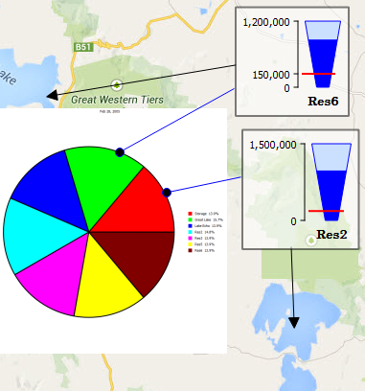
Output Canvas - Highlights
Trapezoidal Teacups
Canvas Lines
Charts on an Output Canvas

Slide 5
Output Canvas - Upcoming
Show Canvas items on Geospatial View
Improved use of charts on canvas
Resizable object icons
Run all animations coordinated at same timestep
Increased export capabilities including PDF format and high resolution options
Resize images in the canvas configuration
Needs funding: Export Canvas Animation to Video File

Slide 6
Charts - Completed
Placement of the legend
New Bar Chart type (improves display of negative values)
Export chart animation to video file

Slide 7
Export Chart Animation to Video File
Full run period (only)
One frame per timestep or coarser sampling
Settable frames per sec.
Choice of:
MP4, WEBM, WMF,
Animated GIF
Frame images only

Slide 8
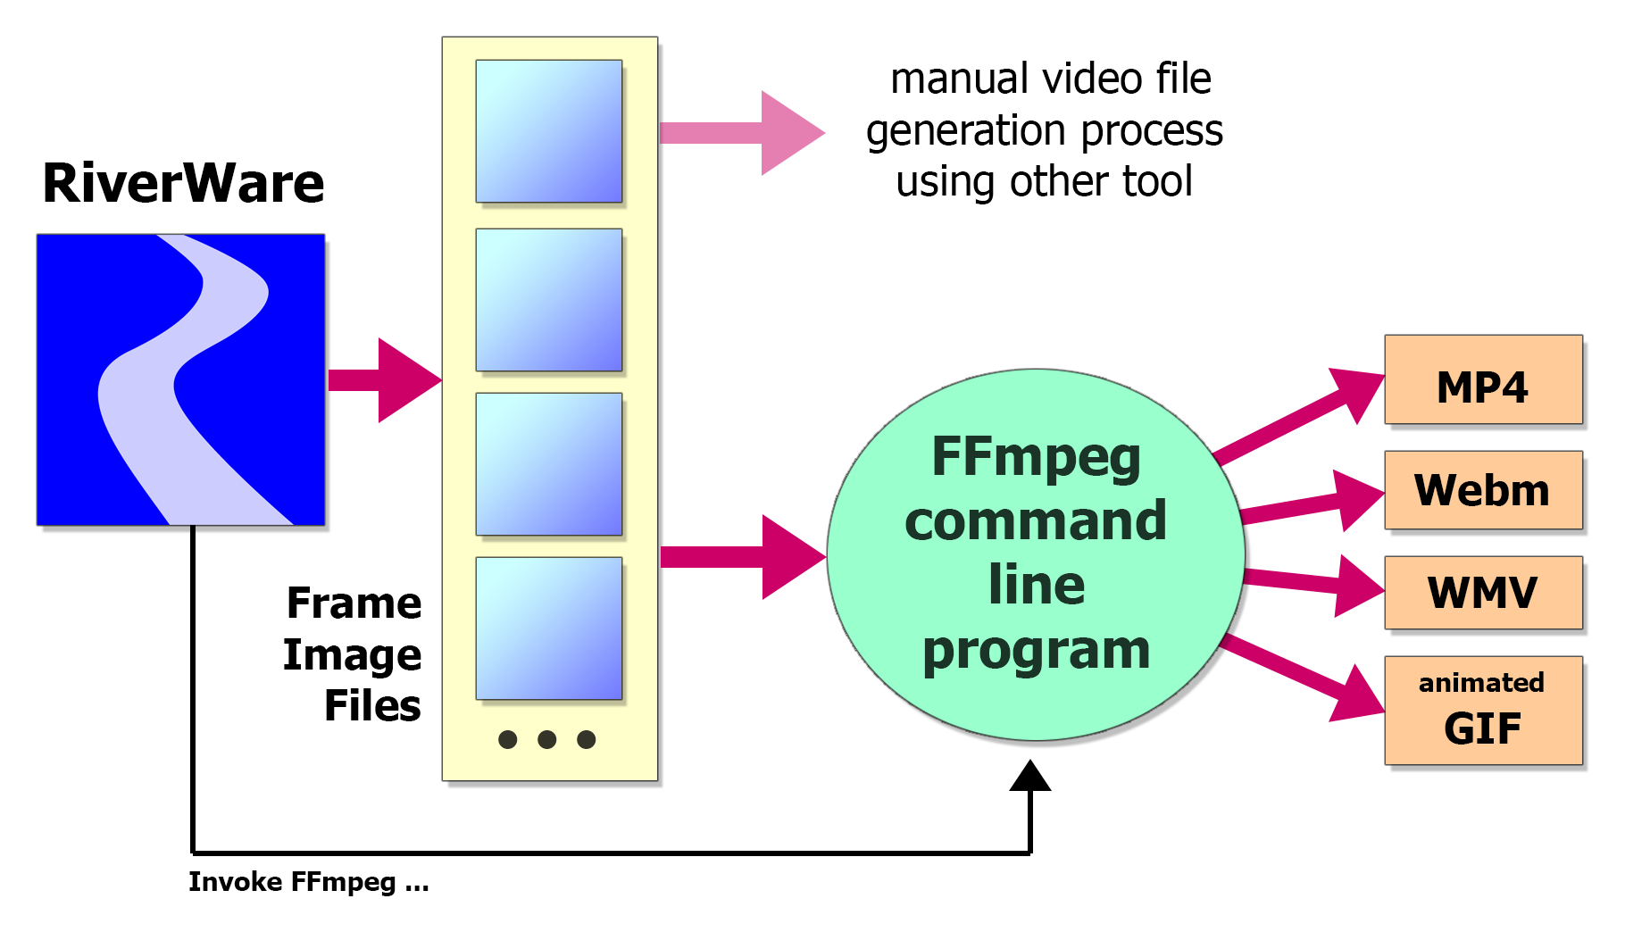
Export Chart Animation to Video File

Slide 9
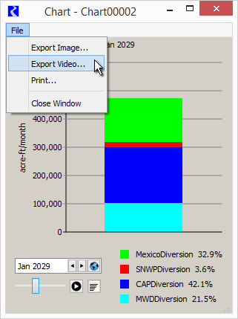
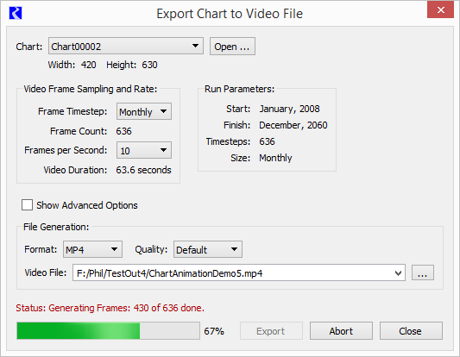

Slide 10
Export Video File
Advanced Options:
Generated frame image directory and names.
Retain frame images?
Extra FFmpeg arguments.
Copy generated FFmpeg command line.

Slide 11
Plotting - Completed
Date/Time axis format
Axis label rotation
Time scaling using symbolic datetimes or funct
Plotting scalars
Legend re-order
Rework of save mechanism (demo)

Slide 12
Plotting - upcoming
Edit multiple plot curves from one dialog
User specified axis units
Develop design for improved Legends and curve layer control
Continue improving how plots are added to curves (unfunded)

