Slide 1
Usability Features
Presenters: Patrick, Phil, and David
RiverWare Sponsors’ Meeting
February 6, 2014

Slide 2
Usability Enhancements / RW 6.3 (5-2013)
Unit Schemes
Smart Linker
Open Object Dialog:
Multiple Slot Operations (e.g. Plotting)
Slot Filtering (Hiding)
Scenario Sandbox
Diag Message Display Filtering

Slide 3
Usability Enhancements / RW 6.4 (11-2013)
Rename Multiple Accounts
Select Methods: Multiple Accounts
Selectable Window Icon
Geospatial View Image Load Improvements
Workspace Object List: Custom Order

Slide 4
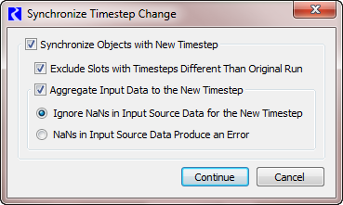
Input Aggregation - Demonstration

Slide 5
Usability Enhancements / RW 6.5 (future)
Completed as of Feb. 2014
Workspace Text and Images
Physical Link Arrows
Object Clusters
… brief demonstration …

