Slide 1
Software Development, Maintenance, Releases and Tech Transfer
2012 RiverWare User Group Meeting
Bill Oakley
February 1, 2012

Slide 2
Software Development Team
Professional software engineers
Continuity and institutional knowledge
Variety of complimentary backgrounds
Professional water resource engineers
Engineering methods
User support
Professional support staff
Software configuration management (licensing, releases)
Hardware maintenance

Slide 3
Software Development Process
Our goal is to deliver professional quality software applications which meet our users’ needs:
Requirements analysis
Requirements document
High level design document
Estimates
Other documents as appropriate
Document reviews

Slide 4
Software Development Process
Implementation
Write code
Unit test (may include writing test code)
Peer code review (correctness, efficiency, coding standard conformance, readability, maintainability),
Integration testing (including regression tests, memory analysis)

Slide 5
Software Maintenance
Bug fixing
Critical bugs fixed for next patch release
Non-critical bugs deferred to next major release
Before major release thorough review of bug list to identify bugs to fix for release
RiverWare development requires many software packages:
Applications or libraries
Commercial
Open Source
Home Grown (Java, Perl, Python, Tcl/Tk)

Slide 6
Software Maintenance
Operating Systems:
Windows: XP, Vista, 7
Solaris: 2.9, 2.10 (last RiverWare release)
RiverWare Functionality: Qt, Qwt, CPLEX, Concert, FlexLM, Reprise, HecGen, heclib, Oracle, MODFLOW, Tcl, zlib
Source Control, Builds, Regression Tests, Releases: CVS, TkCVS (moving to Git and Git Extensions), rw-checkout, rw-config, rw-update, rw-build, rw-rt, modelcomp, cvs-copy.pl, InstallShield, rw-release, rw-install
Compilers, Debuggers, Performance Analysis: Microsoft Visual Studio, Sun Studio, Intel Fortran, Rational Purify and Quantify
Bug Tracking, User Support: Gnats (moving to Bugzilla), Perl CGI scripts, SupportTool
Web Pages, Online Payment System: DreamWeaver, Photoshop, Perl and Python CGI scripts

Slide 7
Software Maintenance
Many pieces to the puzzle and many dependencies between the pieces
New versions of third-party software are continually released
Monitor and evaluate new versions
New versions may be compatible with RiverWare or they may require substantial RiverWare code changes
New versions may affect other third-party software
Estimate effort and schedule upgrade to new version, keeping in mind release schedule
Keeping current requires significant effort

Slide 8
User Support Procedure
All user support questions should be sent to:
riverware-support@colorado.edu
Multiple support staff receive email and most appropriate or available person can respond

Slide 9
Releases
Typically two releases each year, with additional patch releases as necessary
Numbering: RiverWare Major.Minor.Patch where Major = major version number (currently 6) Minor = minor version number (currently 1) Patch = patch level number (currently 2)
Downloading
From the web site: http://cadswes2.colorado.edu/downloads/riverware/releases

Slide 10
Releases
Major releases: RiverWare 6.1
Fully tested and verified (usually including a pre-release)
Include updated online documentation and release notes
Users notified by e-mail and encouraged to upgrade
Patch releases: RiverWare 6.1.2
Generated from last full release with minor enhancements
Tested and verified (usually without a prerelease)
May include updated online documentation
Usually minor enhancements/fixes mentioned in email (also under “notes” link on web site)
Users notified by e-mail but may choose not to upgrade

Slide 11
Snapshots
Development snapshots:
RiverWare 6.2 Development
Generated from previous night’s development area
Should only be used to test new development Should NEVER be used for operations or model building
Only tested by overnight regression tests
Does not include updated online documentation or notes
Concerned users are notified by phone or email

Slide 12
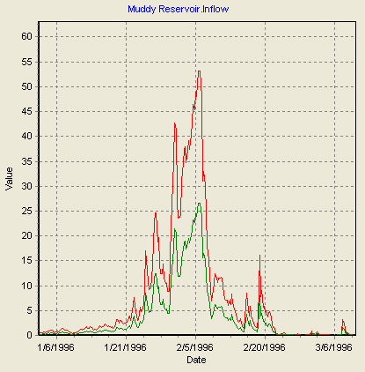
Other Tools available
Modelcomp – RiverWare model comparison tool
Execute from command line
modelcomp model1.mdl model2.mdl
Model files are compared line by line
Slot differences include convergence check
Graphing Options
Both sets of data (-g)
Differences only (-d)
Scaled Differences (-s)
Largest differences are shown first

Slide 13
Other Tools available
GPAT – Graphical Policy Analysis Tool
RdfToExcel
RdfAnnualizer
YAPP – Yearly Aggregation Post Processor
All are available on website

Slide 14
Bugs
Filing Should be done by users, even if CADSWES verifies
Current licensees login to :
http://cadswes2.colorado.edu/downloads
/riverware/issuetracking/index.html
Log in as: rwuser
For password contact RiverWare tech support:
riverware-support@colorado.edu

Slide 15
Include information to reproduce the bug
Events leading to the bug
Exact text of any errors or messages
Model, ruleset, and/or dmi in which bug is manifested
Send model to riverware-support@colorado.edu
ftp models to ftp://cadswes2.colorado.edu/

Slide 16
Bugs
Bug follow-up
Filer is contacted by automated email
Bug tracking system notifies filer when status changes (closed, info added, reassigned)
Web lookup available
Closed bugs documented in release notes or patch email

Slide 17
New Bug Tracking Software
Will be converting from GNATS to Bugzilla
GNATS no longer actively maintained
Homegrown Perl scripts for Gnats interface are limiting and difficult to maintain
Bugzilla is an active open source software
Bugzilla can provide additional capabilities such as filing a model file along with the bug

Slide 18
Training
Intro to Simulation
Classes held when there is enough interest / demand
Class dates chosen to accommodate participants’ schedules
Rulebased Simulation
Typically held a month or two after the Intro class
Need to have completed Intro to Simulation class
Accounting
Typically held a month or two after the Rules class
Need to have completed both other classes
Optimization
Under development
Web-based Special Topics?

Slide 19
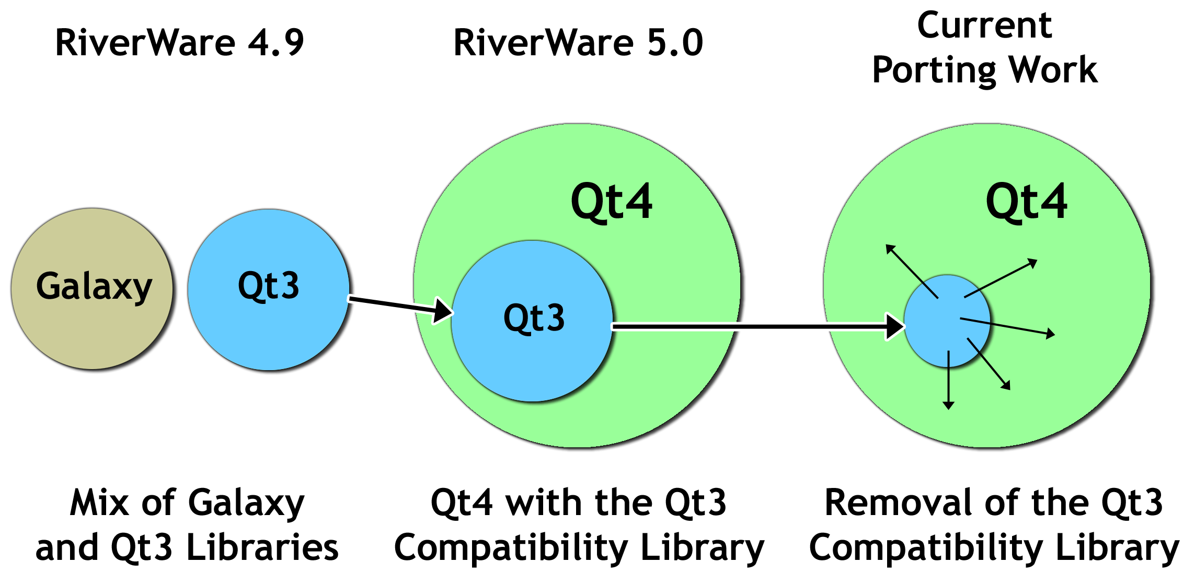
Our Qt Porting Road Map

Slide 20
Qt3 to Qt4 Port Status
 | Feb 2010 | Feb 2012
Qt3 Dialogs | 91 | 11
Qt3 Lists & Tables | 69 | 21
Major Qt3 Components Remaining in 2010
Accounting View | Completed (RW 6.1)
SCT (system control table) | To do
Other Slot Data Display Tables | Completed (RW 6.2)
RPL Expression Frame | To do

