Slide 1
Software Development, Maintenance, Releases and Tech Transfer
2012 RiverWare User Group Meeting
Bill Oakley
February 1, 2012

Slide 2
Software Development Team
Professional software engineers
  Continuity and institutional knowledge
  Variety of complimentary backgrounds
Professional water resource engineers
  Engineering methods
  User support
Professional support staff
  Software configuration management (licensing, releases)
  Hardware maintenance

Slide 3
Software Development Process
Our goal is to deliver professional quality software applications which meet our users’ needs:
  Requirements analysis
  Requirements document
  High level design document
  Estimates
  Other documents as appropriate
  Document reviews

Slide 4
Software Development Process
Implementation
  Write code
  Unit test (may include writing test code)
  Peer code review (correctness, efficiency, coding standard conformance, readability, maintainability),
  Integration testing (including regression tests, memory analysis)

Slide 5
Software Maintenance
Bug fixing
  Critical bugs fixed for next patch release
  Non-critical bugs deferred to next major release
  Before major release thorough review of bug list to identify bugs to fix for release
RiverWare development requires many software packages:
  Applications or libraries
  Commercial
  Open Source
  Home Grown (Java, Perl, Python, Tcl/Tk)

Slide 6
Software Maintenance
Operating Systems:
  Windows: XP, Vista, 7
  Solaris: 2.9, 2.10 (last RiverWare release)
RiverWare Functionality: Qt, Qwt, CPLEX, Concert, FlexLM, Reprise, HecGen, heclib, Oracle, MODFLOW, Tcl, zlib
Source Control, Builds, Regression Tests, Releases: CVS, TkCVS (moving to Git and Git Extensions), rw-checkout, rw-config, rw-update, rw-build, rw-rt, modelcomp, cvs-copy.pl, InstallShield, rw-release, rw-install
Compilers, Debuggers, Performance Analysis: Microsoft Visual Studio, Sun Studio, Intel Fortran, Rational Purify and Quantify
Bug Tracking, User Support: Gnats (moving to Bugzilla), Perl CGI scripts, SupportTool
Web Pages, Online Payment System: DreamWeaver, Photoshop, Perl and Python CGI scripts

Slide 7
Software Maintenance
Many pieces to the puzzle and many dependencies between the pieces
New versions of third-party software are continually released
  Monitor and evaluate new versions
  New versions may be compatible with RiverWare or they may require substantial RiverWare code changes
  New versions may affect other third-party software
  Estimate effort and schedule upgrade to new version, keeping in mind release schedule
Keeping current requires significant effort

Slide 8
User Support Procedure
All user support questions should be sent to:
riverware-support@colorado.edu
Multiple support staff receive email and most appropriate or available person can respond

Slide 9
Releases
Typically two releases each year, with additional patch releases as necessary
Numbering: RiverWare Major.Minor.Patch
where Major = major version number (currently 6)
Minor = minor version number (currently 1)
Patch = patch level number (currently 2)
Downloading
  From the web site:
  http://cadswes2.colorado.edu/downloads/riverware/releases

Slide 10
Releases
Major releases: RiverWare 6.1
  Fully tested and verified (usually including a pre-release)
  Include updated online documentation and release notes
  Users notified by e-mail and encouraged to upgrade
Patch releases: RiverWare 6.1.2
  Generated from last full release with minor enhancements
  Tested and verified (usually without a prerelease)
  May include updated online documentation
    Usually minor enhancements/fixes mentioned in email (also under “notes” link on web site)
  Users notified by e-mail but may choose not to upgrade

Slide 11
Snapshots
Development snapshots:
  RiverWare 6.2 Development
  Generated from previous night’s development area
  Should only be used to test new development
  Should NEVER be used for operations or model building
  Only tested by overnight regression tests
  Does not include updated online documentation or notes
  Concerned users are notified by phone or email

Slide 12
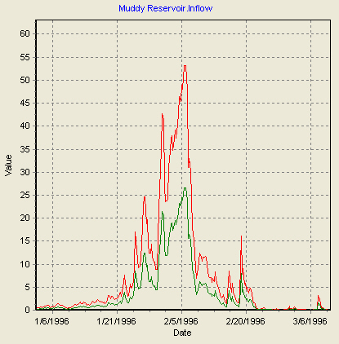
Other Tools available
Modelcomp – RiverWare model comparison tool
  Execute from command line
  modelcomp model1.mdl model2.mdl
  Model files are compared line by line
  Slot differences include convergence check
  Graphing Options
    Both sets of data (-g)
    Differences only (-d)
    Scaled Differences (-s)
  Largest differences are shown first

Slide 13
Other Tools available
GPAT – Graphical Policy Analysis Tool
RdfToExcel
RdfAnnualizer
YAPP – Yearly Aggregation Post Processor
All are available on website

Slide 14
Bugs
Filing Should be done by users, even if CADSWES verifies
Current licensees login to :
  http://cadswes2.colorado.edu/downloads
  /riverware/issuetracking/index.html
  Log in as: rwuser
  For password contact RiverWare tech support:
  riverware-support@colorado.edu

Slide 15
Include information to reproduce the bug
  Events leading to the bug
  Exact text of any errors or messages
  Model, ruleset, and/or dmi in which bug is manifested
  Send model to riverware-support@colorado.edu
  ftp models to ftp://cadswes2.colorado.edu/

Slide 16
Bugs
Bug follow-up
  Filer is contacted by automated email
  Bug tracking system notifies filer when status changes (closed, info added, reassigned)
  Web lookup available
  Closed bugs documented in release notes or patch email

Slide 17
New Bug Tracking Software
Will be converting from GNATS to Bugzilla
  GNATS no longer actively maintained
  Homegrown Perl scripts for Gnats interface are limiting and difficult to maintain
  Bugzilla is an active open source software
  Bugzilla can provide additional capabilities such as filing a model file along with the bug

Slide 18
Training
Intro to Simulation
  Classes held when there is enough interest / demand
  Class dates chosen to accommodate participants’ schedules
Rulebased Simulation
  Typically held a month or two after the Intro class
  Need to have completed Intro to Simulation class
Accounting
  Typically held a month or two after the Rules class
  Need to have completed both other classes
Optimization
  Under development
Web-based Special Topics?

Slide 19
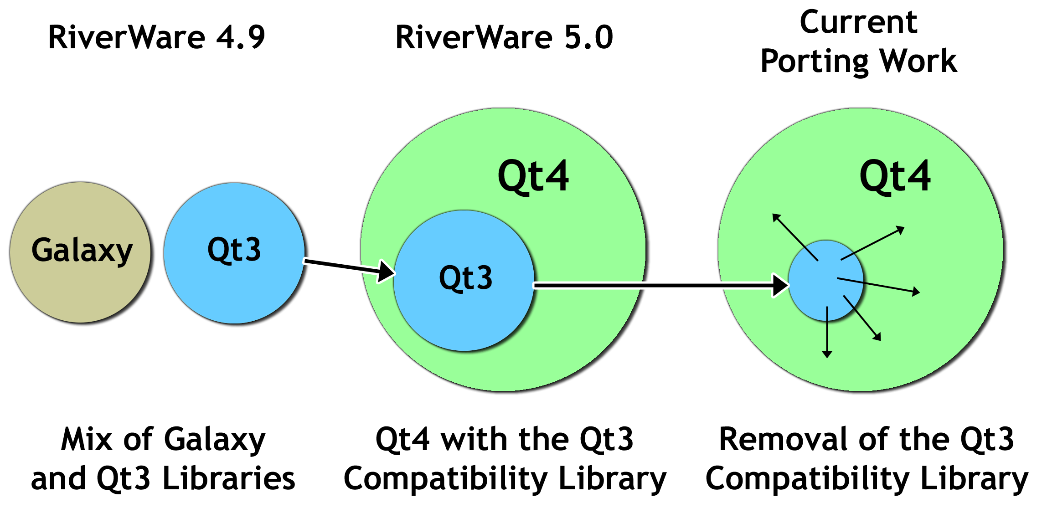
Our Qt Porting Road Map

Slide 20
Qt3 to Qt4 Port Status
 | Feb 2010 | Feb 2012
Qt3 Dialogs | 91 | 11
Qt3 Lists & Tables | 69 | 21
Major Qt3 Components Remaining in 2010
Accounting View | Completed (RW 6.1)
SCT (system control table) | To do
Other Slot Data Display Tables | Completed (RW 6.2)
RPL Expression Frame | To do

