Slide 1
Groundwater Modeling and
Calibration Tools
2012 RiverWare User Group Meeting
David Neumann and Phil Weinstein
February 1, 2012
Notes:
This presentation talks about the groundwater modeling and calibration tools. First lets talk about the Groundwater. Remember, the groundwater storage object models well, storage of water in the ground. It simulates flow between adjacent objects using an explicit equation based on head difference and conductance. So, usually a model has a network of groundwater objects.
Following are some changes to the groundwater object. I’m actually going to talk about these backwards, upcoming work first, then recent changes.

Slide 2
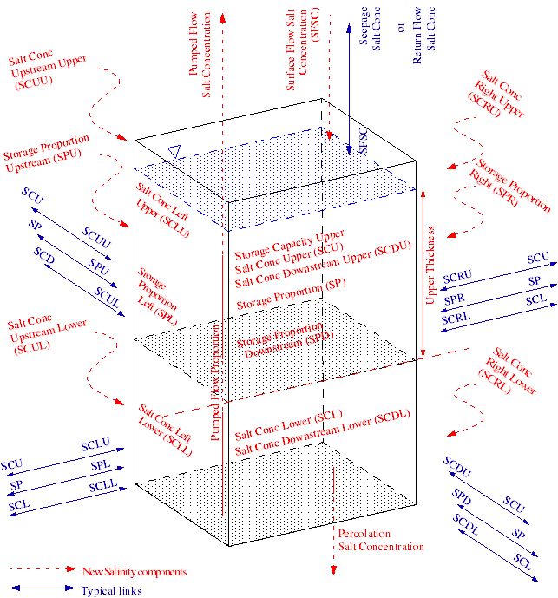
Water Quality on Groundwater
Salinity
Two Layer approach
Work will begin soon
Notes:
First, we have developed a proposed approach to add salinity modeling to the GW object. This is a two layer approach where the thickness of the upper layer remains constant and then the concentration and mass of salt is tracked. This design is under review and we plan to begin work on it soon.

Slide 3
MODFLOW link
Not functional due to library incompatibilities
Disabled in 6.1
Could be fixed with some effort if needed
Notes:
The RiverWare MODFLOW link was found to not be functional due to some library incompatiblities. Nobody is currently using this. To prevent users from trying to use it, we disabled it in 6.1. So you can no longer select the methods. To fix the connection, we just need to sort out the libraries which takes time and we don’t want to do this until someone actually needs it.

Slide 4
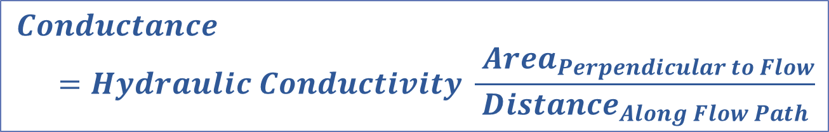
Conductance Calculation
Previously, the user specified:
  Conductance Left
  Conductance Right
  Conductance Up
  Conductance Down
  Deep Aquifer Conductance
  Reach Conductance
Difficult to Calibrate
$$Conductance=Hydraulic Conductivity \frac{ {Area}_{Perpendicular to Flow}}{{Distance}_{Along Flow Path}}$$
Notes:
The other big change on the GW object has to do with conductance. Previously, the user had to specify the conductance in each flow direction.
Well, conductance is actually computed by the Conductivity, the area, and the distance.
This was difficult to calibrate. To try a new conductivity, you had to externally calculate the conductance. Further, if you didn’t have identical conductances on adjacent objects, mass would not be conserved. This made it even harder to work with.

Slide 5

Calculate Conductance
At the beginning of run, use this and adjacent object’s:
  Aquifer geometry (Length, Width, Thickness)
  Hydraulic Conductivity
  Anisotropy Ratio
Adjacent conductance are the same
To be released in 6.2
Notes:
The solution to this is a new method to compute the conductance at the beginning of the run. This method uses the object’s and adjacent objects’s geometry, conductivity and anistropy ratio to compute the conductance in each direction.
This ensures that adjacent conductances are the same.
It will be released in the next version 6.2
A further enhancement to the conductance calculation is to allow there to be a series of conductance on the Reach that is based on the wetted area, which in turn is based on the inflows.
Now let’s move on to more calibration tools that were implemented to help with this groundwater model.

Slide 6
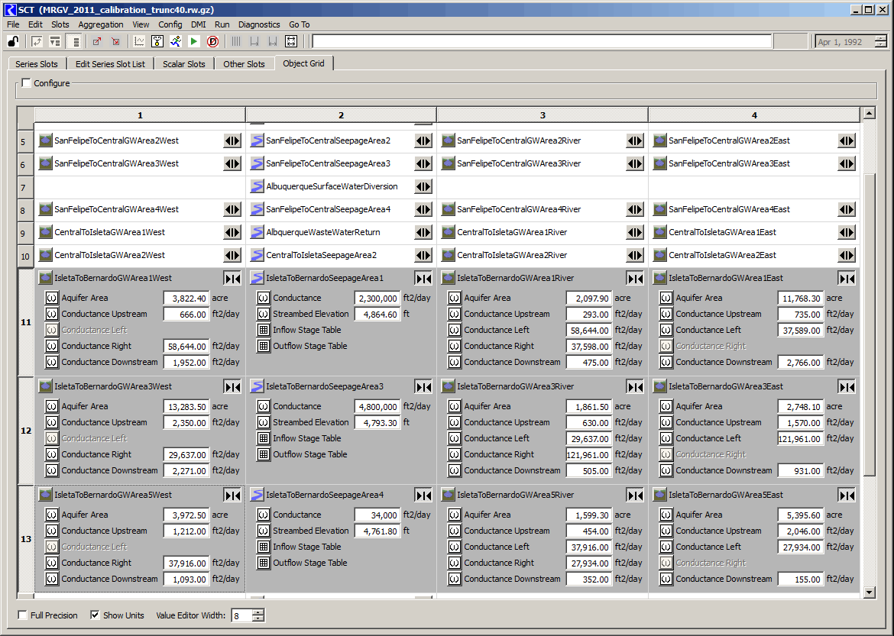
SCT Object Grid Tab (RW 6.1)

Slide 7
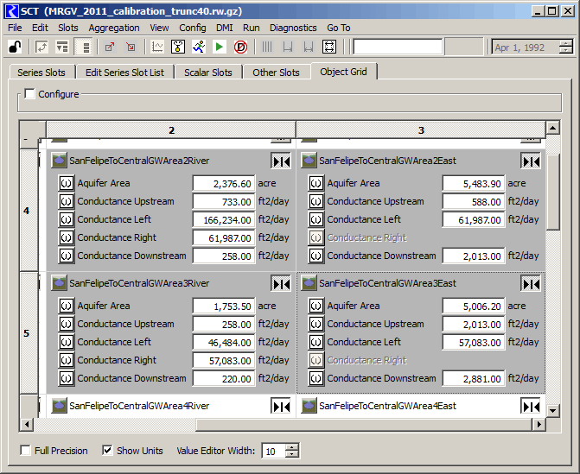
SCT Object Grid Tab (p.2)

Slide 8
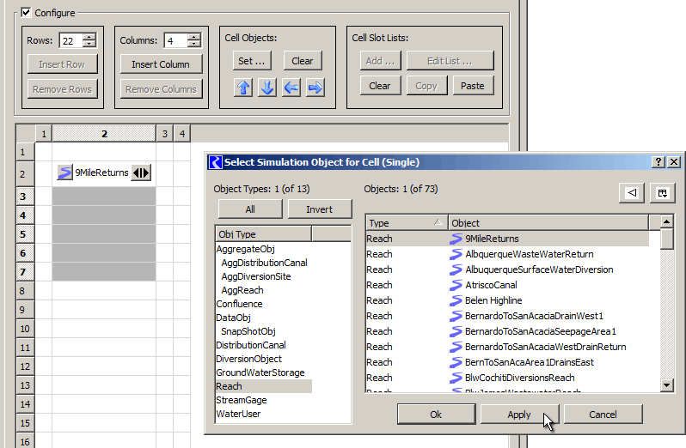
SCT Object Grid Tab (p.3)
High level op: Set sequence of cell objects

Slide 9
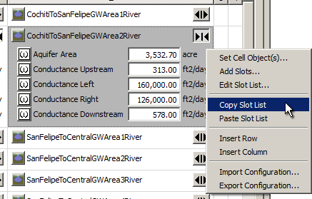
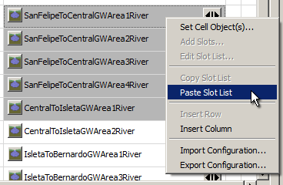
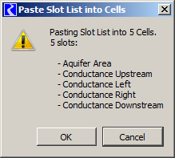
SCT Object Grid Tab (p.4)
High level op: Copy slot list to multiple cells

Slide 10
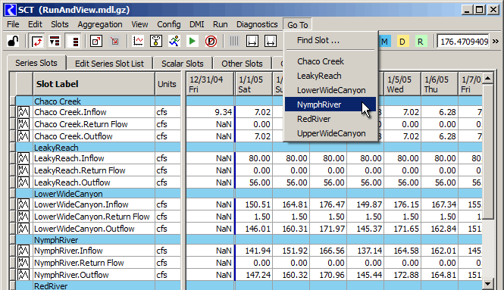
SCT Edit Series Slot List Tab (RW 6.1)
SCT Series Slots Tab: Use of dividers to define groups:

Slide 11
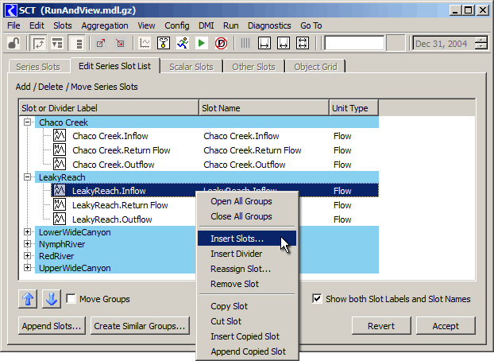
SCT Edit Series Slot List Tab (p.3)

Slide 12
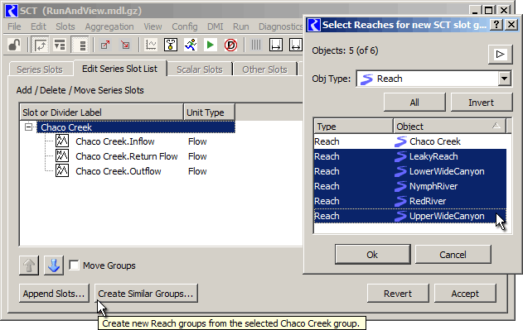
SCT Edit Series Slot List Tab (p.3)
High level op: Create similar groups

Slide 13
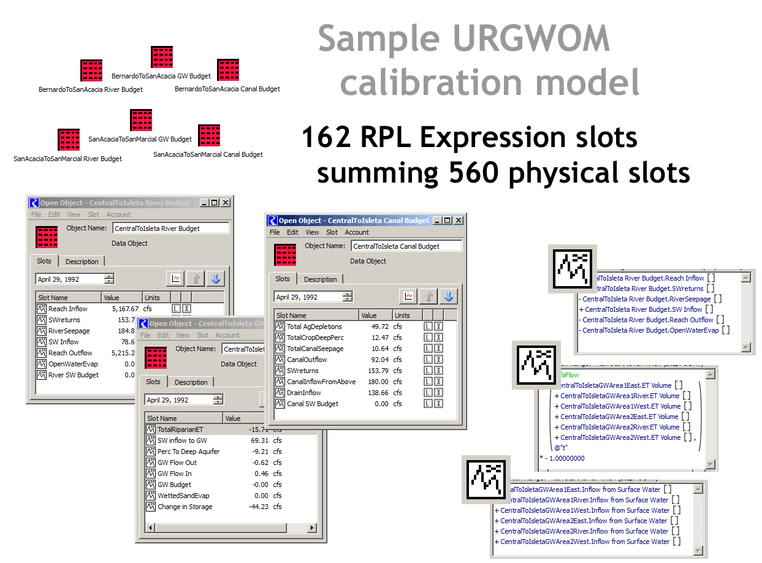
Mass Balance Summary Slots (RW 6.2)

Slide 14
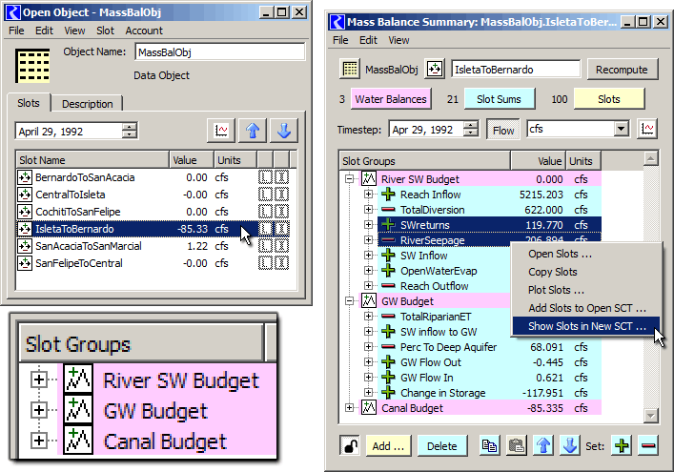
Mass Balance Summary Slots (p.2)

Slide 15
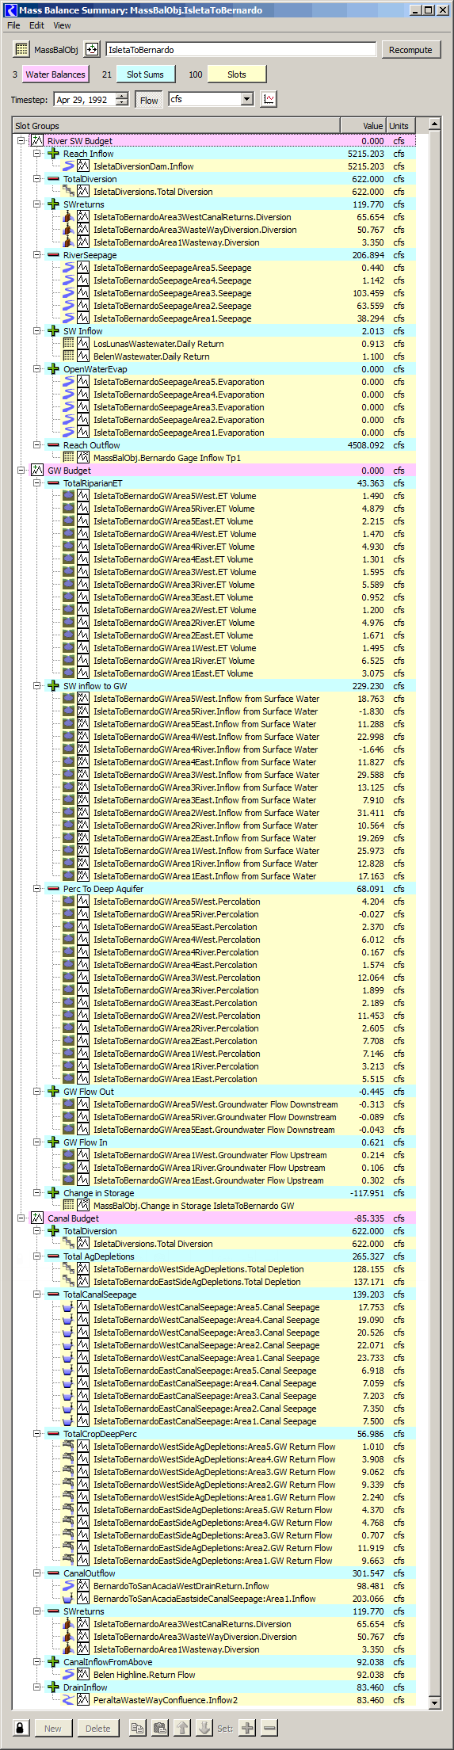
Mass Balance Summary Slots (p.3)
Created as Slots on Data Objects
Three Levels of References to Slots:
  “Water Balances”
  “Slot Sums” (added or subtracted)
  References to Flow or Volume series slots,
  … including RPL expression series slots.
Water Balances and Slot Sums are series slots:
… can be used in RPL expressions.
Viewable in Flow or Volume units
Viewable in SCT, Plots, Open Slot dlg.

